Slide 1
Introduction to MS SQL Server
CIS 483 – Database Security
Computer Information Systems
University of Louisville
Ghiyoung Im, PhD

Slide 2
Agenda
SQL Server 2005 Components
Configuring SQL Server 2005
SQL Server 2005 Instances
SQL Server 2005 Databases
SQL Server 2005 Data Storage Overview
Database Physical Architecture
Database Administration Topics
Notes:
Notes

Slide 3
SQL Server 2005 Components

Slide 4
What is SQL Server?
“Microsoft SQL Server 2005 is a database platform for large-scale online transaction processing (OLTP), data warehousing, and e-commerce applications; it is also a business intelligence platform for data integration, analysis, and reporting solutions.” (microsoft.com)
SQL Server is usually refer to?
Database Server (RDMBS)
Analysis Services is not an RDBMS

Slide 5
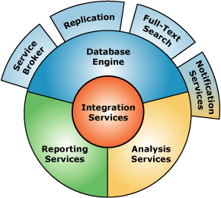
SQL Server 2005 Components
* Source: Microsoft

Slide 6


Microsoft SQL Server History
Microsoft SQL Server 1.0 released in 1989
Shared the source code with Sybase
SQL Server Versions
SQL Server 2000 is version 8.0
SQL Server 2005 is version 9.0
SQL Server 2008 is version 10.0
SQL Server 2012 is version 11.0 (to be released in 2012)
Components
Released with only the Database Engine
OLAP Services (1998)
Analysis Services now
Reporting Services (2002/2003)

Slide 7
SQL Server Versions
SQL Server 2000 (8.0)
SQL Server Reporting Services introduced (free download after the release)
SQL Server 2005 (9.0)
SQL Server Reporting Services available on installation
SQL Server Integration Services introduced <- DTS (data transformation services)
SQL Server 2008 (10.0)
New datatypes, better XML integration
Management policies (cf. Group policies in Windows)
Security enhanced
SQL Server 2012 (11.0)

Slide 8
SQL Server Database Engine
The core component of SQL Server 2005 and stores mission-critical data
Design, create, and manage a database that holds the relational tables or XML documents
Retrieve the data stored in the database quickly
The Online Transaction Processing (OLTP) engine for SQL Server
Highly optimized for transaction processing
Replicate data across network
Support failover

Slide 9
SQL Server Analysis Services
Online Analytical Processing (OLAP) and data mining engine for SQL Server
Stores multidimensional data for OLAP
Can drill down and rollup through “cubes”, “measures”, and “dimensions”
For data mining, analyze large quantities of data to find relationships and patterns
Generally run on a separate machine for performance

Slide 10
SQL Server Integration Services
Support enterprise-level data integration and data transformations
MS E.T.L solution
Extract, Transform, and Load
Import and export data, and transform along the way
Replace a predecessor, Data Transformation Services (DTS)
Can use GUI tools for transformation

Slide 11
SQL Server Reporting Services
Centralized reporting server that supports design, deployment, and management of reports
Can use relational or multidimensional data from different data sources (e.g., Oracle, DB2, MS Access, MS Excel, text files, XML)
Can explore data interactively and create various reports
Can create ad-hoc reports that use predefined models

Slide 12
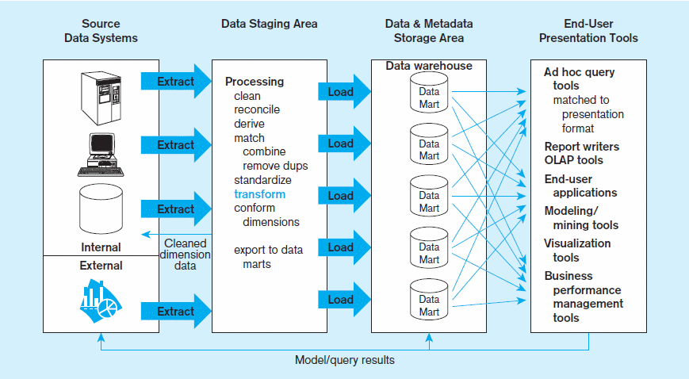
Data warehouse & Data Mart
* Source: Hoffer et. al

Slide 13
Other Components
Service Broker
Supports queuing and messaging between SQL Server instances (or within a single instance)
New technology in SQL Server 2005
Replication
Supports the copying and distribution of data and database objects
Full-Text Search
Enable full-text queries (e.g., words and phrases) against plain character-based data in SQL Server tables
Notification Services
Used to create customized messages subscribers

Slide 14
SQL Server Editions
Express
Free (but, 1CPU, 1G RAM, 4G database size limit)
Workgroup
User or CPU-based license (but, limit on CPU and RAM)
Standard
Most popular (CPU limit, but no RAM limit, 64-bit/32-bit, 500GB databases)
Developer
For testing and development
Enterprise
Most expensive (no hardware limits, 64-bit/32-bit, terabyte-size databases)

Slide 15
Configuring SQL Server 2005

Slide 16
SQL Server Configuration Manager
Purpose
Manage SQL Server services
Configure the network protocols
Manage the network connectivity for SQL Server client computers
A Microsoft Management Console (MMC) snap-in

Slide 17
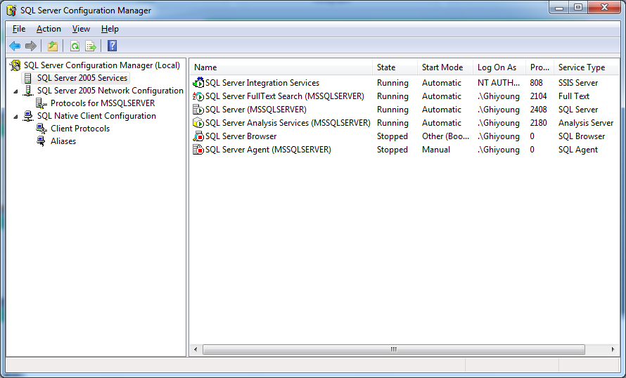
SQL Server Configuration Manager

Slide 18
SQL Server 2005 Services
SQL Server Browser
A Windows service
When a client connects by name, SQL Browser looks for the name in its list and send out the connection data for that instance
SQL Server Agent
A Windows automation tool
Alerts: Reports errors
Jobs: Transferring data or backing up a trans
SS 2005 Network Configuration
SQL Native Client configuration

Slide 19
SQL Server Communication
Clients communicate with the server via SQL Native Client
A data access API for OLE DB and ODBC.
SQL Server supports the following protocols:
Local connections use Shared Memory by default
TCP/IP: standard
Also supports Named Pipe and VIA protocols
SQL Server default port: 1433
Named installations use dynamic port
SQL Server Browser service helps resolving dynamic ports

Slide 20
SQL Server Surface Area Configuration
Enable, disable, start, or stop the services and remote connectivity of your Server installations
Has two types:
Surface Area Configuration for Services and Connections
Surface Area Configuration for Features
Services and Connections
Control services and remote connections
Features
Enable and disable advanced features

Slide 21
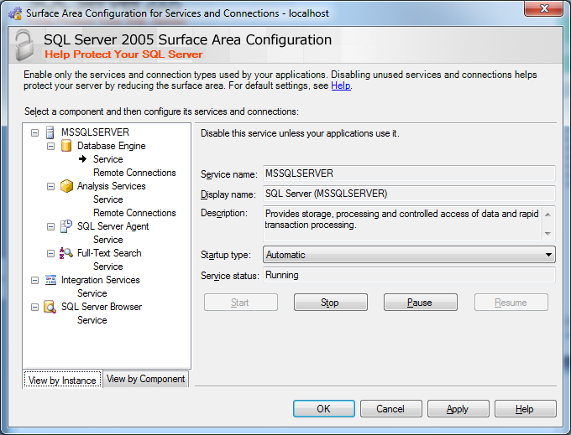
Surface Area Configuration for Services and Connections

Slide 22
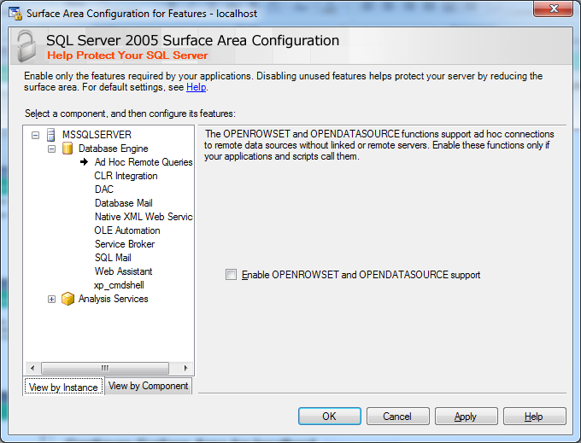
Surface Area Configuration for Features

Slide 23
SQL Server 2005 Instances

Slide 24
SQL Server Instances
Each installation of SQL Server creates an instance
Each instance has its own environment (e.g., user databases and a set of system unique to it)
Multiple instances can be created only by running SQL Server setup multiple times
Can install multiple instances of Database Engine, Analysis Services, and Reporting Services on the same machine
The highest item in data storage hierarchy

Slide 25
SQL Server Instances - Types
Instances can be of two types
Default Instance
Named Instance
Default instances identified by the name of the computer on which the instance is installed
Only one default instance allowed in a computer
To identify Named Instances, provide the name of the server on which the instance is installed + the name of the instance
Machine Name\Instance Name

Slide 26
SQL Server 2005 Databases

Slide 27
SQL Server Databases
A database stores tables and related objects to manage data
One SQL Server 2005 instance can store many databases (up to 32,767)
One database can store many objects (more than 2 billion)
A maximum database size (524 PB – Enterprise, 2008R2)
A typical instance has five system databases and multiple user databases

Slide 28
SQL Server 2005 – System Databases
SQL Server has five system databases and one hidden system database
Master
MSDB
Model
Tempdb
Resource (Hidden)
System databases contain system objects like system tables, views, and stored procedures
System objects is used to manage internal data

Slide 29
SQL Server 2005 – System Databases Description
Master
Stores the information that is applied to the server (e.g., logins, linked servers, configuration, user tables)
Cannot start the server without it
MSDB
Used by SQL Server Agent, Service Broker, Database Mail, log shipping
Keeps the job’s parameters and history of database backup and restore
Model
A template on which user-created databases are built
Changes to the model database are applied to all databases created afterward

Slide 30
SQL Server 2005 – System Databases Description
TempDB
Contains temporary objects (e.g., temporary tables, temporary stored procedures) or intermediate result sets (e.g., large sort operations, index operations)
Resource
A new addition in SQL Server 2005
Actual database name is mssqlsystemresource.mdf and mssqlsystemresource.ldf
Stores all the system objects (system stored procedures, system views) that appear logically in each database, but physically stored in the database
Hidden and can’t directly access

Slide 31
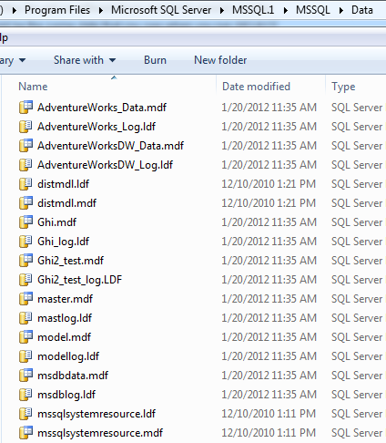
Location of SQL Server Databases
select * from sys.master_files

Slide 32
SQL Server 2005 – User Databases
User databases contain a set of user created database objects
User databases also contain system objects that maintain information about objects in the specific database
A user database’s name must be unique in an instance
User databases can be created by SSMS, TSQL, SQL Server Management Objects (SMO)
SSMS (GUI) for one-time usage
TSQL, SMO for reuse

Slide 33
Database Physical Architecture
SQL Server 2005 Data Storage Overview

Slide 34
SQL Server 2005 –Database Files
Each database is stored in a set of OS files
Each database has at least two files
Data file
Transaction log file
Each database can have a maximum of 32,726 files
Database files can be classified into:
Primary Data File
Secondary Data Files
Transaction Log Files

Slide 35
SQL Server 2005 –Database Files
Primary Data File
The firstdata file created
Track all the other data files used by the database
Every database must have one and only one primary data file
Generally has .mdf extension
In many cases, this is the only data file
Secondary Data File
Can have zero or more files in a database
Generally has .ndf extension
Useful for large databases and enhancing performance
Flexible in backing up and copying

Slide 36
SQL Server 2005 –Database Files
Transaction Log Files
Log files contain a group of database changes
Each database must have at least one log file
Generally the extension is .ldf
Prevent significant data loss and is very important for data recovery
Every write in a database is done inside of a transaction
Write Ahead Logging
All transactions are written to the log first and next to the data file

Slide 37
SQL Server 2005 – Database File Properties
The database files can be stored on single drive or on multiple drives
Every database file has a logical file name and a physical name
Logical name: file manipulation uses this name (default=database name)
Physical name: can’t be changed while online
The database file growth and size can be handled in two modes
Autogrow parameters:
Grow the file by a percentage or a fixed amount
Set max size (recommendation)

Slide 38
SQL Server 2005 –File Groups
A database can have n filegroups
A filegroup can have n data files
A data file belongs to a single filegroup
Transaction log files do not belong to any filegroup
Helps easy data placement and backup/restore on a specific filegroup
Types of filegroups
Primary
User Defined
Default

Slide 39
SQL Server 2005 –File Groups
Each database has a primary filegroup
The primary data file belongs to the primary filegroup
Every database has one primary filegroup
User defined filegroups created explicitly
The secondary data files can belong to user defined filegroups
The primary file group is the default filegroup

Slide 40
SQL Server 2005 – Schema
User-Schema separation in 2005
A collection of database objects that one user owns and that forms a single namespace (ANSI definition)
In SQL Server 7.0 and 2000, a default schema was created for each user and its name was the same as the user
The schema and owner were the same
In 2005, the owner and schema separated
A database user can have a default schema, which is different from the user name
Also, the default schema for a user can be one of built-in schemas by SS (by default, it is “dbo”)

Slide 41
SQL Server 2005 – Schema
When reference an object, we use a four-part name:
SELECT * FROM Server.Database.Schema.Object
If on the same server, can skip the server name
SELECT * FROM Database.Schema.Object
If in the correct database, can skip the database
SELECT * FROM Schema.Object
What is the query to a table (Employee) in the ComA_DB while you were in the ComB_DB?
If your default schema = your object’s schema, can omit the schema (e.g., dbo)
SELECT * FROM Object : not recommended

Slide 42
Database Administration Topics

Slide 43
SQL Server 2005 – Metadata Views
In earlier versions of SQL Server, system tables were directly queried for database metadata
In SQL Server 2005, system tables are accessible via a new set of views
Compatibility Views
Kept for backward compatibility. Earlier system tables are available via this view (e.g., sysobjects -> sys.objects, sysindexes -> sys.indexes)
Catalog views
Preferred method of viewing system info (e.g.,sys.master_files, sys.databases)
Dynamic management views
Provide diagnostic info – system state (more flexible)
Activity Monitor (Management -> Activity Monitor)

Slide 44
SQL Server 2005 – Managing Services
Microsoft SQL Server runs on a Windows operating system as a service
A service is an application that runs in the system background without having a user interface
SQL Server Database Engine, SQL Server Browser, SQL Server Agent, etc run as a service, respectively
Can start the Service automatically or manually

Slide 45
SQL Server 2005 – Managing Services
SQL Server services can be managed
Using SSMS
Using SQL Server Configuration Manager
Using the Services snapshot snap-in like Computer Management
Managing SQL Server services and setting the server configuration options requires serveradmin or sysadmin roles
Can start and stop services and configure the server options that Windows provides
How to build your own custom MMC for SQL Server?
Type MMC
File -> Add/Remove snap-in -> Select snap-ins of your interest
File -> Options -> Change to user mode

Slide 46
SQL Server 2005 – Linking Servers
Allow Transact-SQL statements against any other data sources
Login credentials are stored with the definition (pre-configured)
Cf. Specify data source at run-time (OPENQUERY(), OPENROWSET(), OPENDATASOURCE() )
Typically used to handle distributed queries on heterogeneous data sources across the enterprise
In SSMS, go to Server Objects and right-click
Distributed objects from a linked server requires a four-part object name
linked_server_name.catalog.schema.object_name

